Slide 1
Which one is a Cetacean

Slide 2
What makes them mammals

Slide 3
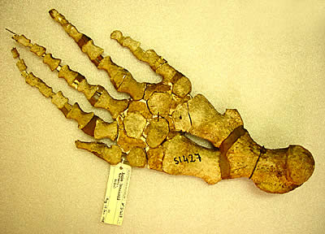

Slide 4
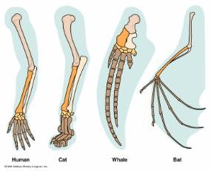

Slide 5
Mysteceti/Baleen Whales

Slide 6
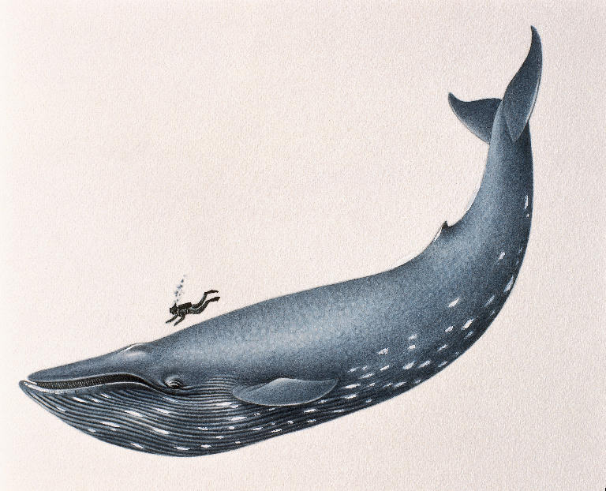

Slide 7
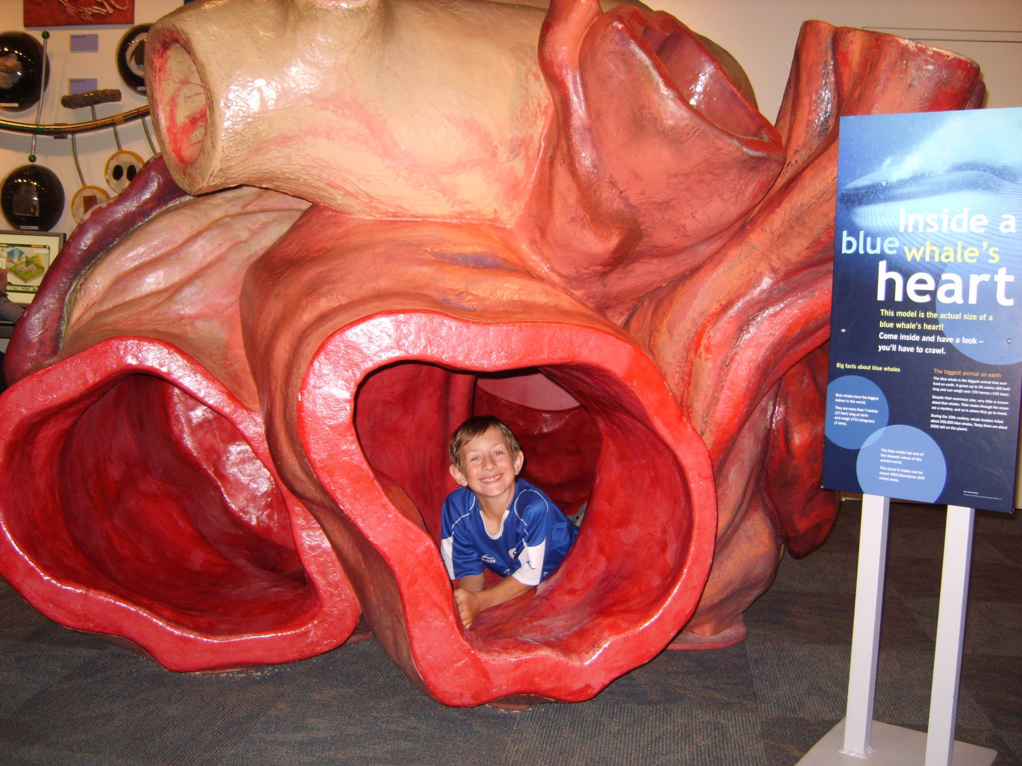

Slide 8
At a length of 100 feet, and weighing in at 400,000 lbs, they are the largest animals ever on Earth

Slide 9
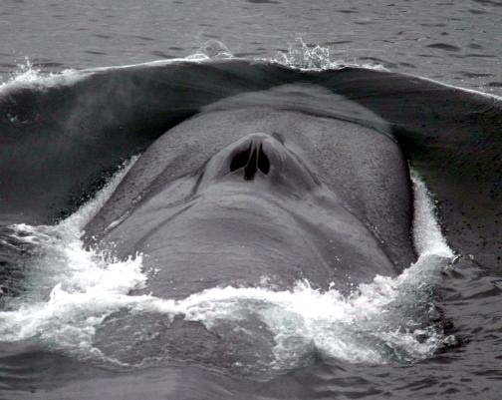

Slide 10
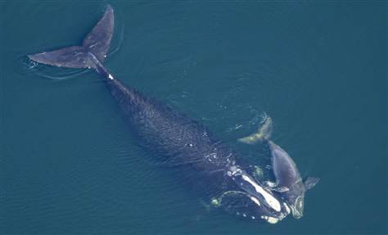

Slide 11
Right whales are named because they move slow they are big, and float when killed

Slide 12
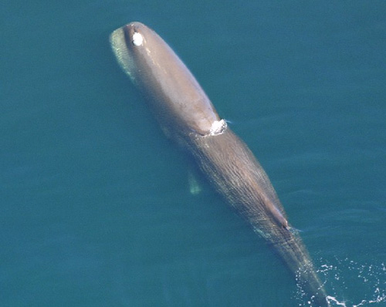

Slide 13
Third largest whale, 66 ft, prefers tropical to temperate waters

Slide 14
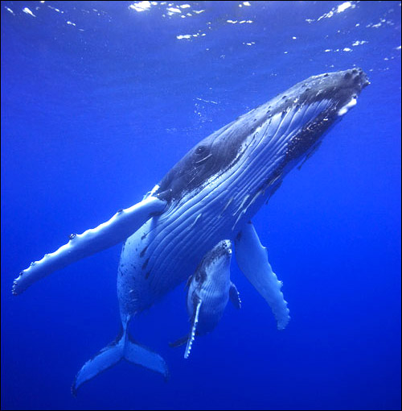

Slide 15
Known for -singing - distinct body shape which includes very large pectoral fins - very acrobatic -eat only in the winter near the poles and migrate towards the equator to give birth

Slide 16
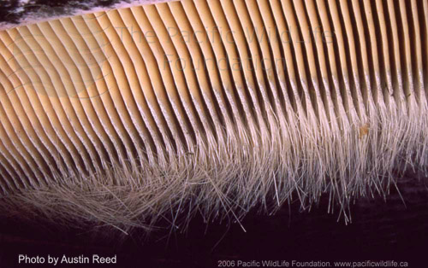
Have Baleen

Slide 17
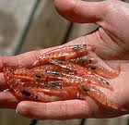
What does the largest animal on Earth feed on?

Slide 18
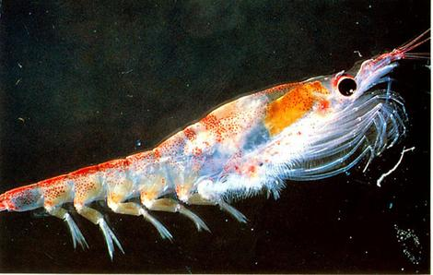

Slide 19
Amazing hunting technique http://www.youtube.com/watch?v=vJvfjiCTvq4 humpback eating/ bubble netting

Slide 20
Bubble Netting This hunting technique is unusual. Whale dives along a school of small fish and swims around it releasing a stream of bubbles which enclose the school Fish refuse to swim through bubbles Whale swims upwards through enter of school and eats

Slide 21
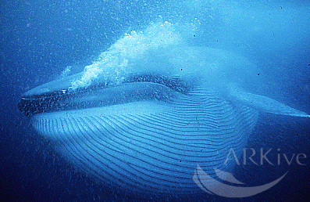
Baleen whales communicate through a series of clicks
Some sing complex songs (humpback)

Slide 22
Why do they sing?

Slide 23
Other behaviors include breaching.

Slide 24
Lob-tailing

Slide 25
http://www.youtube.com/watch?v=62RpSHIkUDo humpback singing

Slide 26
Spy-hopping

Slide 27
http://www.youtube.com/watch?v=yB2KvyiFUws spy hopping http://www.youtube.com/watch?v=qoP1N0OyFic http://www.youtube.com/watch?v=itvjYohS55w&feature=related http://www.youtube.com/watch?v=6KEXUaIlqzA&feature=related http://www.youtube.com/watch?v=xrUFZ13C3Q8

Slide 28
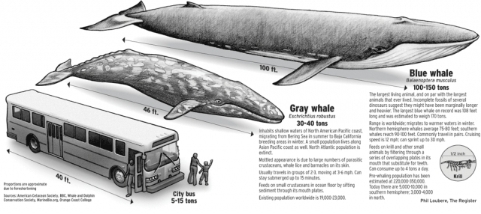

Slide 29
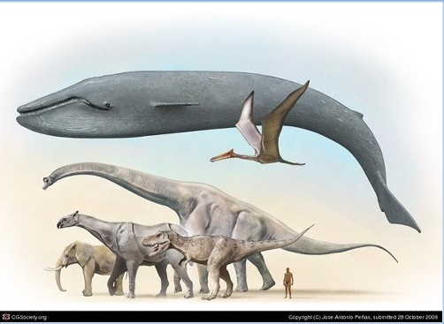

Slide 30
Blue Whales Communicating
http://video.nationalgeographic.com/video/animals/mammals-animals/whales/whale_bluecalls/

Slide 31
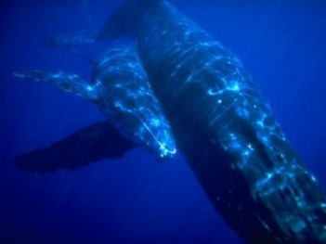
Blue Whale: Population Size?
Reproduce very slowly, every 2-3 years
Gestation period is 12 months

Slide 32
Blue Whale
Found in every ocean
Aggressively hunted for oil and blubber
1930-1931 ~30,000 were hunted and killed
An estimated 350,000 blue whales were killed; 99% of the population wiped out
How many remain today???

Slide 33
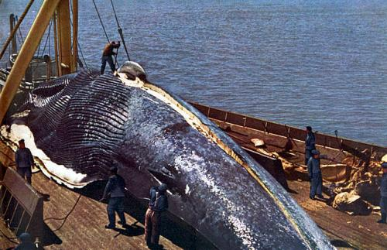
.
Less than 10,000 in the Oceans !

Slide 34
Odonteceti

Slide 35
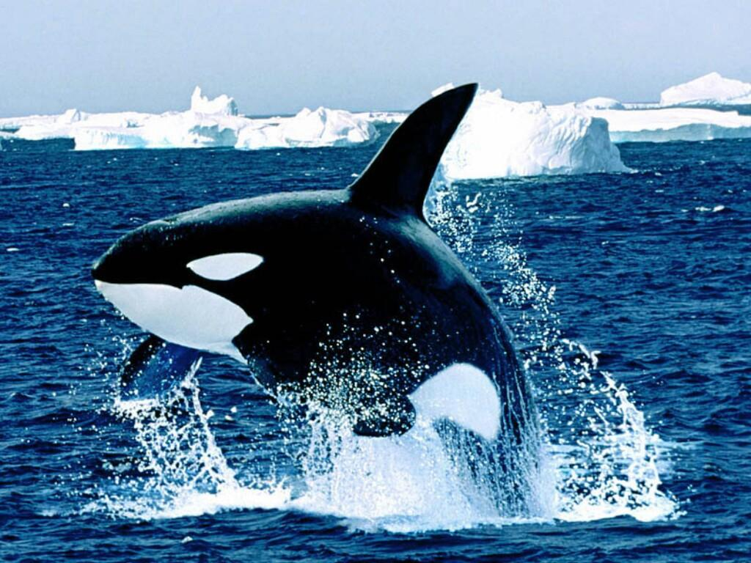

Slide 36
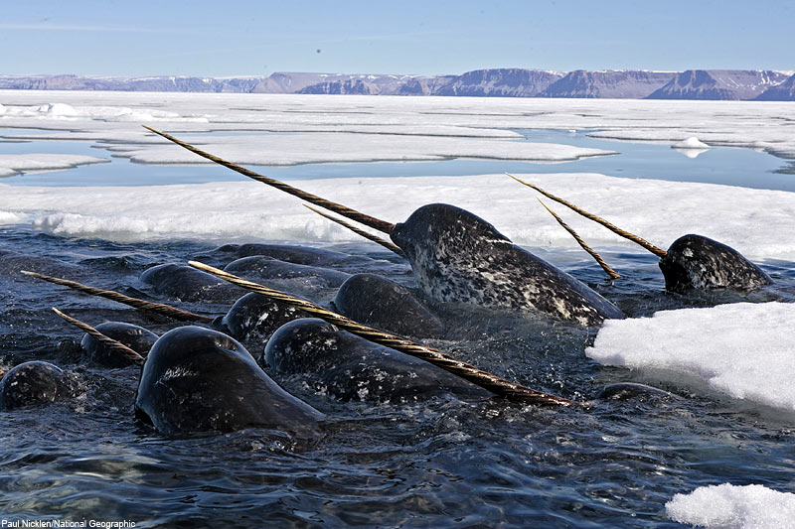

Slide 37
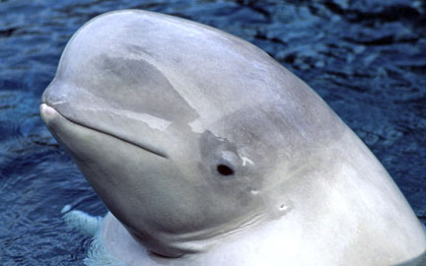

Slide 38
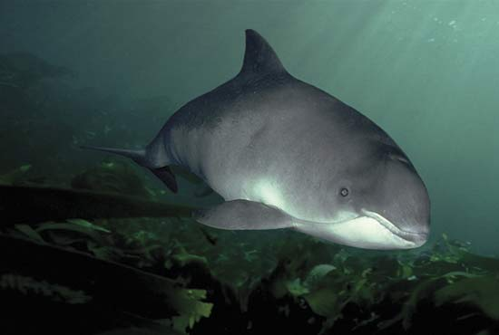

Slide 39
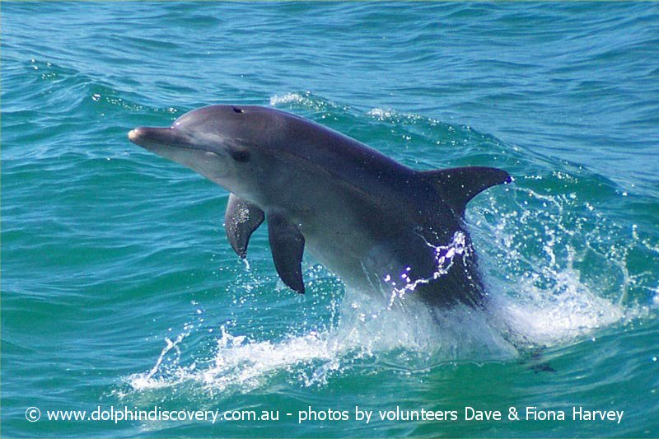

Slide 40
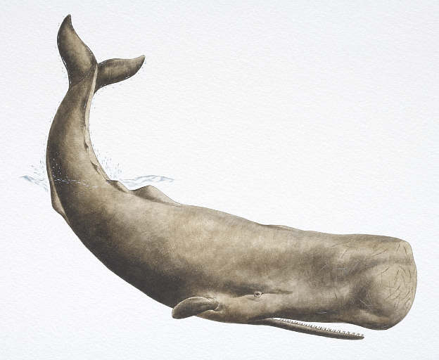

Slide 41
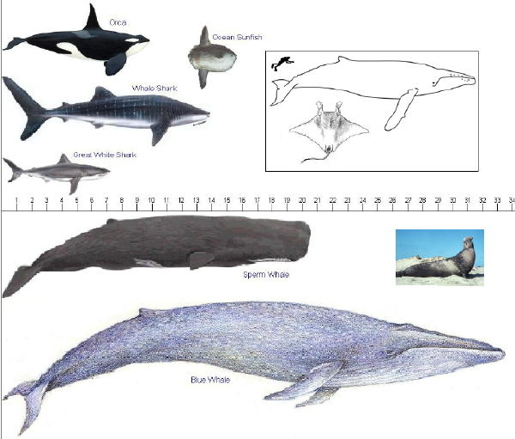

Slide 42
Characteristics Include: Conical shaped teeth

Slide 45
Carnivorous

Slide 46
http://www.youtube.com/watch?v=cg6VXFOtRsU dolphins hunting http://video.nationalgeographic.com/video/animals/mammals-animals/whales/orca-juvenile-training-lex/ killer whales gang up on a seal

Slide 47
Very social

Slide 48
Have conical shaped teeth (*porpoises have spade shaped teeth)
Generally smaller than mysticeti
Are carnivorous
Can dive up to 2000 meters and hold their breath for up to 90 minutes
Over 65 species with the Sperm Whale being the largest (about 60 feet long)
Communicate while hunting using signature clicks
Live in Pods
5 – 30 individuals
Establish strong social bonds

Slide 49
Some mate for life

Slide 50
Some old males live solitary lives

Slide 51
Are very social, more social than mysticeti
Live and travel in groups as large as 1000 whales
Mate with one partner for life
Females and offspring travel in these groups accompanied by last year’s offspring
Some older males like Moby Dick, live solitary lives
May migrate – wintering near the equator and summering near the poles

Slide 52
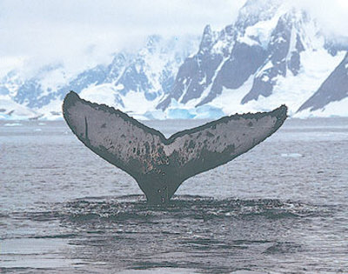
Flukes (All whales)

Slide 53
Each lobe of the tail is called a fluke
Flukes have no bones or muscles
Muscles of the back and caudal peduncle move flukes up and down
http://www.youtube.com/watch?v=InUrAHyggDY

Slide 54
Blubber 3-12 inches thick

Slide 55
Reduced limb size to concentrate heat

Slide 56
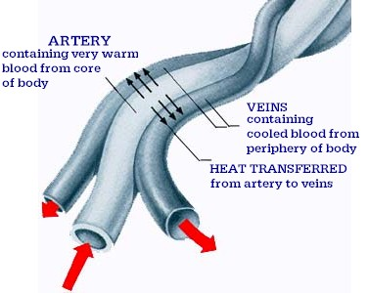
Thermoregulation

Slide 57
Thermoregulation

Slide 58
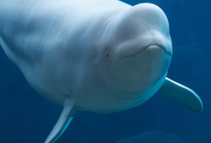

Slide 59
Most Whales have a thick layer of fat (blubber) 3-4 inches thick
Reduced limb size decreases amount of body exposed to environment
Countercurrent heat exchange where arteries are close to veins to keep them warm

Slide 60
http://video.nationalgeographic.com/video/animals/mammals-animals/whales/orca-juvenile-training-lex/ killer whales gang up on a seal
http://www.youtube.com/watch?v=f7-y8LC50r8&feature=related sperm whale

Slide 61
Sperm Whale

Slide 62
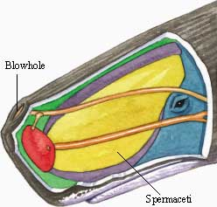

Slide 63
Largest Whale Head is big because it is filled with a milky white waxy substance called spermacetti. Used for diving Spermacetti accounts for 20% of the whales weight. While the head accounts for ¼ of its’ length Deep divers reaching 10,000 feet. Hold their breath for up to 90 mins Feed mainly on giant squid and other fish

Slide 64
http://www.youtube.com/watch?v=qaidpx3b0Jg&feature=related http://www.youtube.com/watch?v=xsxxjANm3hI&feature=related http://www.youtube.com/watch?v=_z2Lfxpi710&feature=related

Slide 65
How do they find food at 10,000 feet down? Use echolocation.

Slide 66
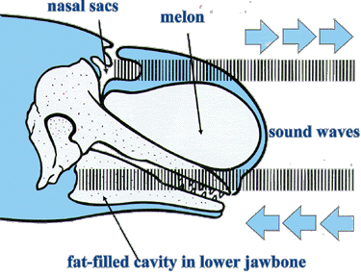
Echolocation

Slide 68
Echolocation in a sperm whale

Slide 69
1. Clicks are produced by the nasal (air)sac 2. Sounds are focused by the melon which is a flexible, fat filled organ 3. Echoes are returned and received by the fat filled lower jaw and transferred to the inner ear. 4. The signals are then processed by the brain and produce an image

Slide 70
This will allow whales to dive deep into the dark depths of the ocean without getting hurt. In sperm whales, the sound is produced by a monkeys muzle

Slide 71
http://www.youtube.com/watch?v=qLziFMF4DHA blind boy

